Slide 1
COMP 3064
Game Development
Week 12 Environment and Lighting

Slide 2
Today:
3D Environment and Lighting
•
Skybox
•
Level Building & Lighting
•
Terrain Editing

Slide 3
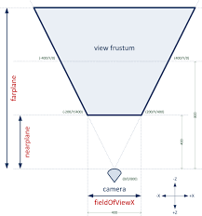
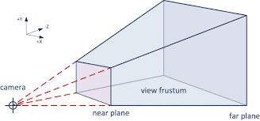
View Frustrum

Slide 4
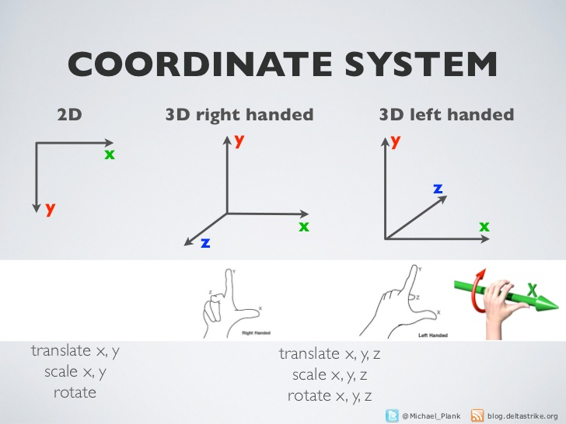

Slide 5
Unity uses a left-handed coordinate system

Slide 6
Skybox
•
Wraps around the entire scene.
•
Gives the impression of a vast environment beyond your scene world.
•
Box made up of 6 textures for each box face.

Slide 7
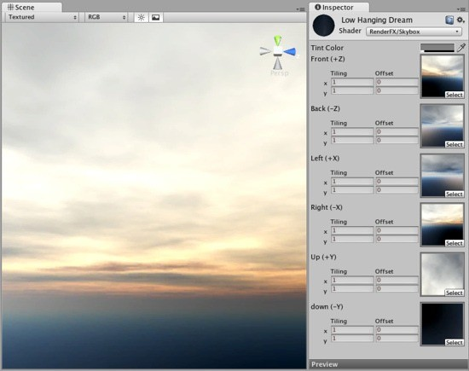
Skybox

Slide 8
Skybox
Adding a Skybox:
Render Settings > Skybox Material
or
Add Component > Skybox to a game object with a Camera component. Then set its Skybox material under Custom Skybox property.

Slide 9
Skybox
•
Try out some sample Skyboxes in:
Standard Assets > Skyboxes
•
You can import these via:
Assets > Import Package > Skyboxes

Slide 10

Demo

Slide 11
Modular 3D Environments
•
Building finished level “modules” or “components”.
•
Assembling those modules into a complete level.
•
Reusability of modules across levels (and games).
•
Power of Prefabs!
•
Allows level designers to tweak a level inside Unity, without having to reimport the entire level as one mesh.
•
Example: Generic room walls, corridors, stairs.

Slide 12
Demo

Slide 13
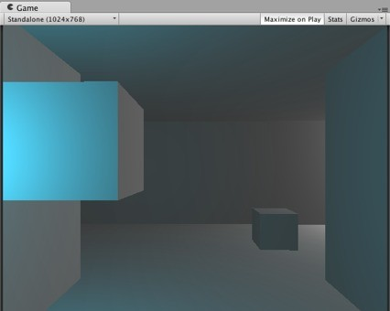
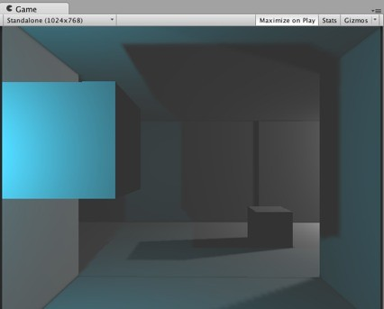
Lighting
Lightmapping (Static Lighting)
Dynamic Lighting

Slide 14
Dynamic Lighting
•
“Dynamic” means changing.
•
Light source illumination of all scene objects computed each frame.
•
Light sources include: point light, spotlight, directional light.
•
Dynamic lighting can change its properties while the game is running.
E.g. position, colour, intensity.

Slide 15
Lightmapping (Static Lighting)
•
“Static” means not changing.
•
Only static objects can have a lightmap applied.
•
Computes scene illumination via dynamic light sources and bakes the result onto a lightmap shared by all static objects.
•
Lightmap is an auto-generated texture based on the computed light and shadows.
•
Lightmap is then applied to all static objects in the scene.

Slide 16
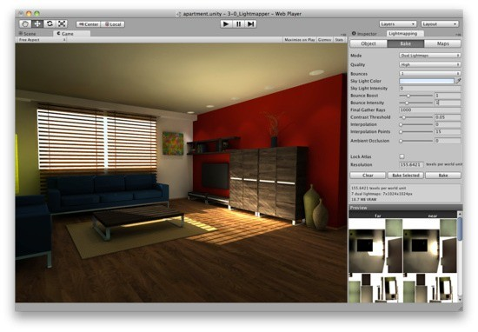


Lightmapping (Static Lighting)
Lightmap texture

Slide 17
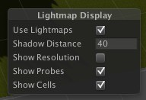
Lightmap Display (Scene View)

Slide 18
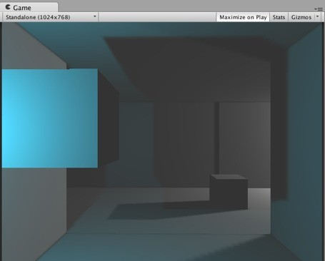
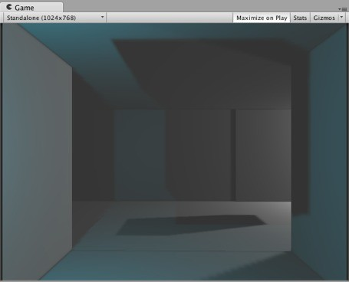




Lightmap
•
Removing static objects during runtime will not remove their cast shadows, since light and shadows are baked onto the lightmap texture.

Slide 19
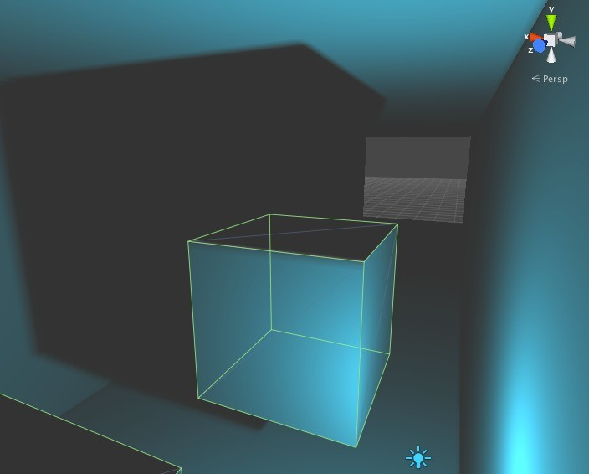
Static Object Present

Slide 20
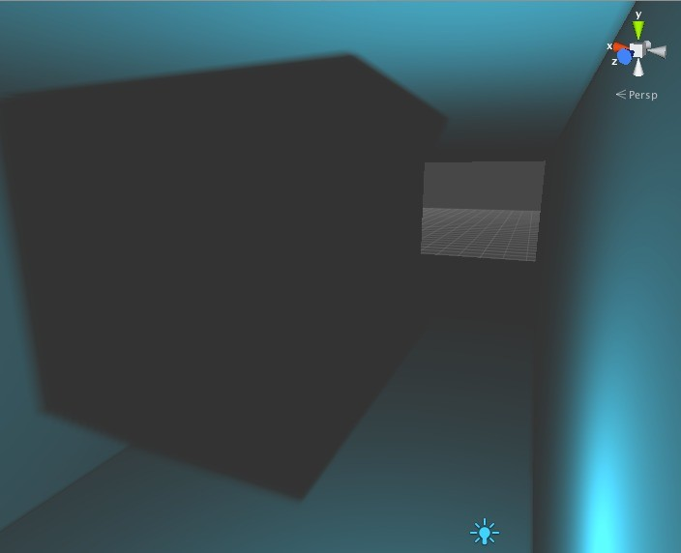
Static Object Removed

Slide 22
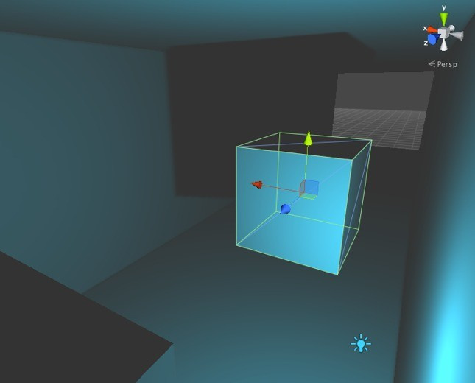
Static Object Relocated and Lightmap Baked Once More

Slide 23
Demo

Slide 24
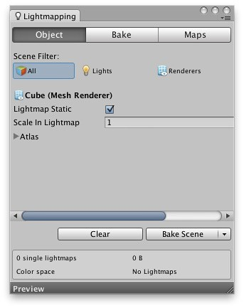
Lightmaps
•
Static object’s mesh must have lightmap UVs.
•
Unity’s primitive shapes (e.g. cube) have lightmap UVs.
•
You can generate UVs from the mesh import settings.

Slide 25

Lightmaps
How much lighmap resolution to dedicate to this mesh.
Greater value means sharper image.
(meshes only)

Slide 26
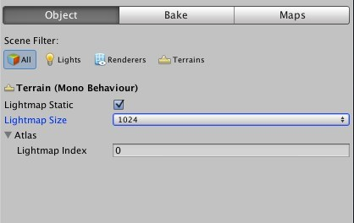

Lightmaps
Size of the entire lighmap.
(terrains only)

Slide 27
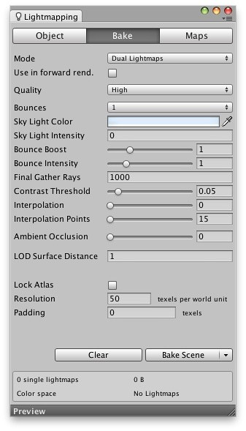

Lightmaps
Controls baking and runtime lighting behaviour.
Enable Dual Lightmaps to see dynamic lights on top of the lightmap.

Slide 28

Lightmaps
Lighmap resolution in texels per world unit.
50 texels means, 50 x 50 pixels of the lightmap occupy 1 x 1 unit of square scene space.
Greater number means sharper lighmap (e.g. sharper shadows).

Slide 29
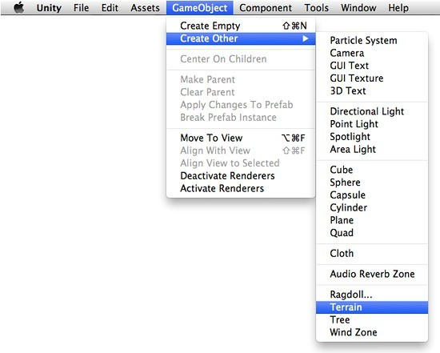
Terrain Editing

Slide 30
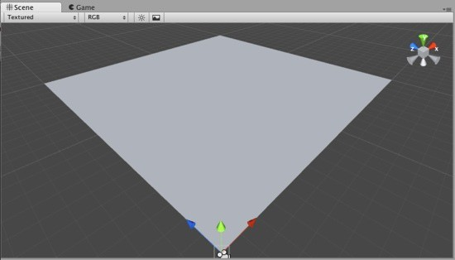
Terrain Editing

Slide 31
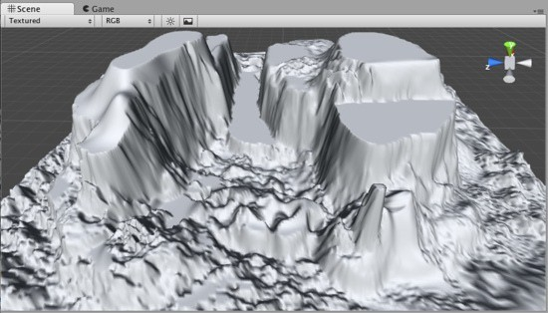
Example Terrain

Slide 32
Demo

Slide 33
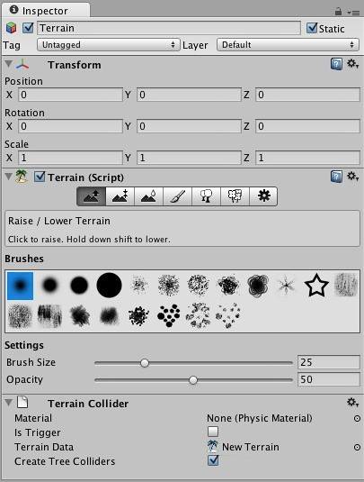

Terrain Editing
Left click to raise
Shift + left click to lower
Raise / Lower Terrain

Slide 34
Terrain Editing
Left click to force height
Paint Height
Shift + left click to sample new height

Slide 35
Terrain Editing
Smooth Height

Slide 36
Terrain Editing
Paint Texture

Slide 37
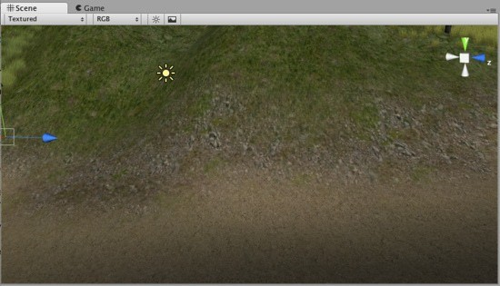
Terrain Textures

Slide 38
Terrain Editing
Left click to place trees via brush shape
Place Trees
Shift + left click to erase trees via brush shape

Slide 39
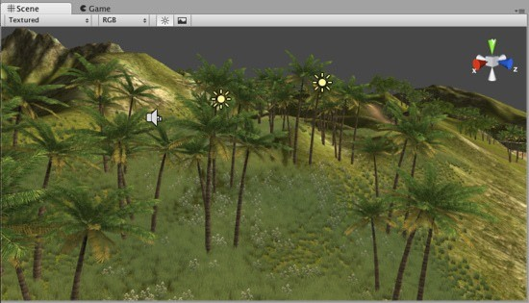
Terrain Trees

Slide 40
Terrain Editing
Left click to place selected detail object
Shift + left click to erase
Paint Detail Objects
e.g. blades of grass, rocks

Slide 41
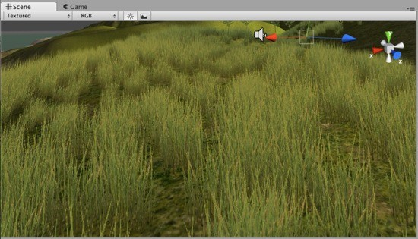
Terrain Grass

Slide 42
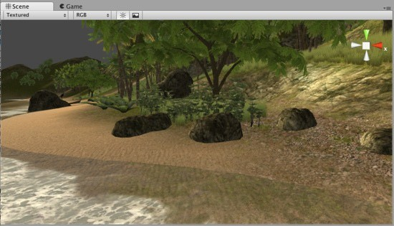
Terrain Detail Meshes

Slide 43
Terrain Editing
Terrain Settings

Slide 44
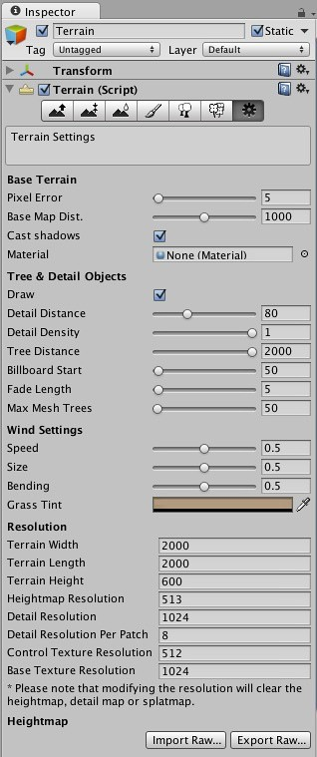

Terrain Settings
Level of Detail (LOD) settings.
Greater Pixel Error = less dense geometry
Greater Base Map Dist. = high resolution terrain texture at greater observable distance

Slide 45

Terrain Settings
Level of Detail (LOD) settings for trees and detail objects.
Controls how far away from the camera will the objects stop being displayed.
Greater distance = more impact on performance

Slide 46

Terrain Settings
Terrain size and height map resolution.

Slide 47
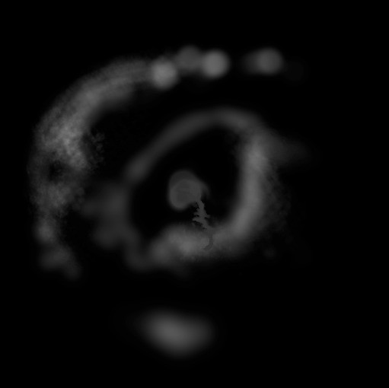


Terrain Settings

Slide 48
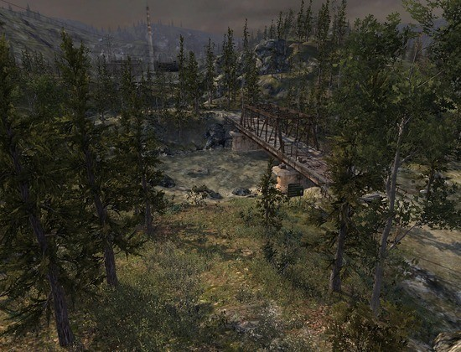
Terrain Lightmaps

Slide 49
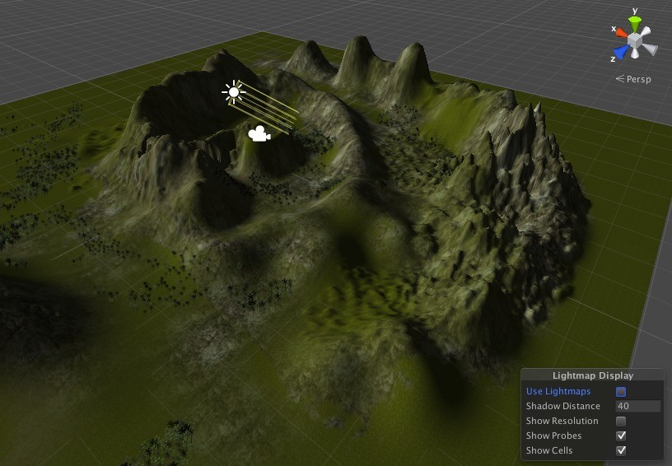
Without a Lightmap

Slide 50
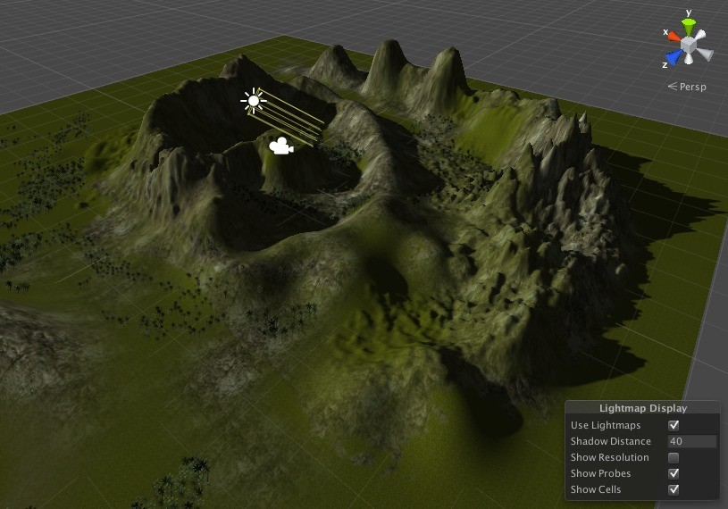
With a Lightmap

Slide 51
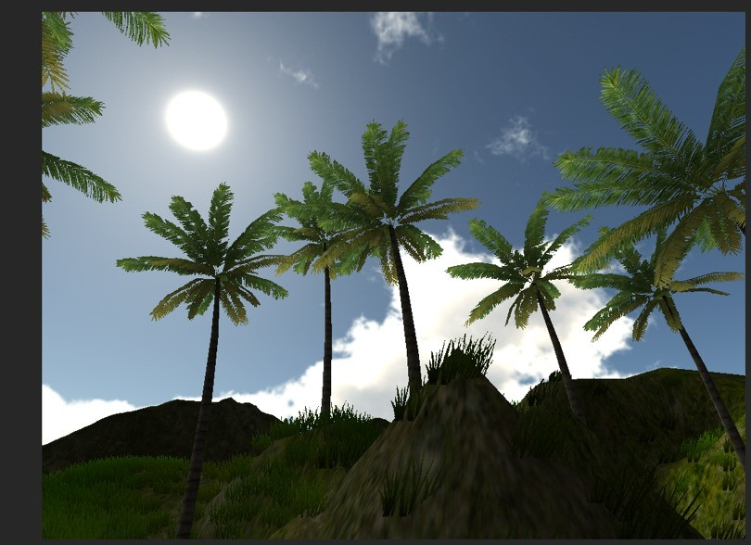
Demo

